Slide 1

WELCOME COHORT FOUR!
  Facilitator: Victor O. Kolade, MD Core Faculty, Internal Medicine Residency, The Guthrie Clinic; Professor of Medicine & Regional Clerkship Director for Internal Medicine
  National Advisory Council: Elisa Arespacochaga, MBA, Vice President, Clinical Affairs and Workforce, American Hospital Association and Sherry Turner, DO, MPH, Representative of the American Association of Colleges of Osteopathic Medicine
Ascension St. Vincent Evansville
Ascension St. Vincent Evansville
St. Lukes University Health Network
Pediatrics EM
Push Dose
Guthrie Robert Packer Hospital
X + Y
Inbasket
Resident Education- Alcohol
Tradition to Transformation
NI X Meeting Three Storyboard Presentations

Slide 2

11:35 – 1:45 pm: Storyboard Presentations
Welcome & Introductions
  Facilitator: Victor O. Kolade, MD Core Faculty, Internal Medicine Residency, The Guthrie Clinic; Professor of Medicine & Regional Clerkship Director for Internal Medicine
  National Advisory Council: Elisa Arespacochaga, MBA, Vice President, Clinical Affairs and Workforce, American Hospital Association and Sherry Turner, DO, MPH, Representative of the American Association of Colleges of Osteopathic Medicine
Assign a Timekeeper
8-10 Minute Storyboard Presentations
Purpose: Share & Learn = Please provide feedback & join in discussion after each presentation
1:35 – 1:45: Overall Reflections from Facilitator & National Advisory Council
1:00 – 1:10 pm: Suggested Break time
(Facilitators and team to determine when/if a short break is needed)
Notes:
Read the slide which describes today’s objectives Be sure to note there are two options for time keeping:
If you take the 10-minute break:
7 projects @120 minutes = 12-minute presentations & 5 minutes for group feedback
If you do not take the 10-minute break:
7 projects @ 130 minutes = 13-minute presentations & 5 minutes for group feedback

Slide 3
Ascension St. Vincent

Slide 4
Graduate Education and Resource Alignment for Social Determinants of Health and Patient-centered care (GRASP)
Gautam Dagur, MD, PhD; Colin M. Mackay, MD; Jesse E. Doyle, MD; Jacob K. Weinzapfel, MD; Robert D. Ficalora, MD

Slide 5
Background and context
Relevant Social and Moral Determinants of Health are no longer incentivized as a standard quality metric during inpatient hospitalization
10 - 20%
Transitions of care remain high risk for patients with unaddressed barriers; these lead to readmissions, missed appointments and adverse outcomes
of health outcomes are driven by medical care
Up to 80–90% reflect social, behavioral, and environmental factors; where people live, eat, work, and whether they can get to a clinic.
There is a great need for a standardized approach to identify and individualize social support intervention, and educate providers on local resources
The post discharge/transitional care clinic is the perfect point for guided intervention
Notes:
Anything else from earlier slides to build on

Slide 6
Aim, Objectives and Alignment
Among internal medicine patients, we will identify individual health barriers to increase post-discharge clinic attendance to 80% over a 6 month period, educate our residents on a targeted SDOH curriculum and observe the impact on 30 day readmissions, ED visits, and mortality
This aligns well with Ascensions’ institutional priority to provide high value, holistic care for our most vulnerable patients while training striving for excellence in training residents to meet the needs of todays’ clinical environment

Slide 7
Measures
Patient outcomes
Study design
Attendance, loss to follow-up and resource use
Retrospective/prospective observational study
Hybrid type 2; observing effectiveness and implementation
Data: EHR (inpatient) + REDCap (outpatient), resident survey data
Educational outcomes
Knowledge of local resources & confidence addressing barriers
System outcomes
30-day readmission, ED visits and mortality
Notes:
Anything else from earlier slides to build on

Slide 8
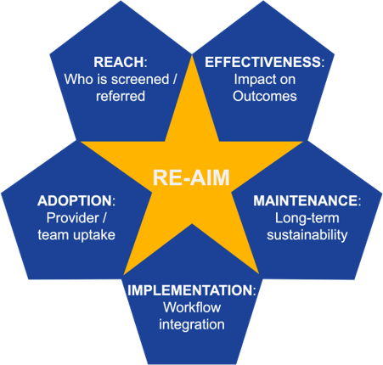
Interventions/Changes
Retrospective/prospective observational study of an educational intervention
IRB exempt
Good resident engagement
Hybrid type 2; observing effectiveness and implementation, RE-AIM Framework guiding implementation
Data: EHR (inpatient) + REDCap (outpatient) and resident survey data
Notes:
Anything else from earlier slides to build on

Slide 9
Barriers/strategies
Anticipated barriers
May not be able to directly compare core 5 due to loss of incentive with CMS changes
Outpatient reference data delay will be more difficult to access
Strategies
Good points of contact with the quality/informatics department
Good engagement with residents
Opportunity for integration with new inpatient service to guide PDC referrals
Notes:
Anything else from earlier slides to build on

Slide 10
Baseline data: patient/system outcomes
50%
39%
clinic attendance rate
Patients lost to follow-up
Notes:
Anything else from earlier slides to build on

Slide 11
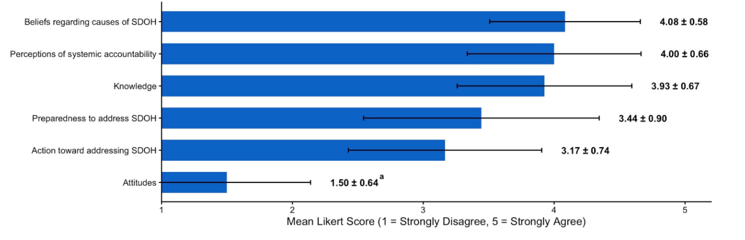
Patients lost to follow-up
Results: resident perception/engagement on SDOH
Notes:
Anything else from earlier slides to build on

Slide 12
Discussion
Crucial next steps
Implement SDOH curriculum and deliver in the PDC workflow
Operationalize PDC referrals through inpatient service line
Reconcile EHR reconciliation and complete multivariate analysis
Track system outcomes, likely on a compressed time frame
Potential areas of input
Addressing attribution within two interventions, optimized PDC referrals and educational intervention
How to address the likely loss of core-5 with CMS changes for data comparison
relevance/benefit/feasibility of tracking resident behaviour in addition to awareness, engagement and attitude
Notes:
Anything else from earlier slides to build on

Slide 13
St. Lukes University Health Network
(Pediatrics EM)

Slide 14




Simulation-based Neonatal and Pediatric Resuscitation Training for Emergency Medicine Residents at SLUHN
Colin Donnelly DO, Genevieve Schmitt MD, Kayla Wilson MD, Andrew Townsend MD, Parampreet Kaur MD
Introduction: Background & Context
Interventions/Changes
Results: Preliminary
A relative lack of exposure to neonatal and pediatric resuscitations leads to decreased preparedness among EM residents potentially compromising patient safety. This project seeks to enhance EM residents’ confidence and competence in these high acuity low occurrence (HALO) scenarios through the implementation of a structured simulation curriculum.
No sims:
  Confidence pre: 2.16
  Confidence post: 3.47
  Scores pre: 50%
  Scores post: 80%
1-2 sims:
  Confidence pre: 2.29
  Confidence post: 3.67
  Scores pre: 49%
  Scores post: 77%
3-5 sims:
  Confidence pre: 3.23
  Confidence post: 3.36
  Scores pre: 56%
  Scores post: 76%
Overall:
  Confidence pre: 2.3
  Confidence post: 3.72
  Scores pre: 50%
  Scores post: 78%
Simulation curriculum consisting of neonatal and pediatric resuscitation cases, each followed by debriefing sessions to ensure learning obtained from each simulation
Using averages of scores in confidence and knowledge assessments as a whole and subcategories of individuals based on levels of experience
No longer tracking individual progress throughout the study, but instead tracking progress based on how many simulations
Aim/Objectives/Alignment
Measures
To evaluate the impact of simulation on residents’ knowledge, clinical decision-making, and procedural skills in neonatal and pediatric resuscitations
To assess changes in residents’ self-reported confidence in leading neonatal and pediatric resuscitations
Identify areas for curriculum improvement based on performance metrics and participation feedback
To determine the number of simulation sessions required for residents to achieve sufficient exposure and demonstrate competency within a simulation curriculum
Pre and post-simulation surveys inquiring self-reflection of comfort level as well as knowledge-based questions to assess the effectiveness of their learning
Measure confidence using likert scale questions
Measure improvement in pre- and post-survey scores to assess the effectiveness of the simulation curriculum.
Determine number of simulations needed to complete to achieve equalization of pre and post survey confidence intervals and scores
Barriers - Strategies
Discussion
Availability for participation based on resident schedules
-> Now with monthly simulations during conference when the most residents are available
Different levels of exposure to neonatal resuscitation based on if resident is on an off service rotation where they do not attend conference
-> Categorized data based on exposure levels vs individual progress
Next steps:
Acquiring bulk of data and formal analyses with appropriate data analysis tools and calculations.
Barriers & challenges:
Finding time in conference that will not take away from other curriculum already scheduled.
Increasing post survey participation.
Reliance on resident self-reporting to accurately track the number of simulations completed for analysis
St. Luke’s GME emphasizes continuous improvement in resident education. This study highlights the need for increased familiarity and comfort with neonatal and pediatric resuscitation, which simulation may help address.
Notes:
Introduction Background and Context
-Use Toolkit #1 – Determining Your Project’s Focus
Aim/Ob
- Try to make it “SMARTIE” (Specific, Measurable, Attainable, Relevant, Timely, Inclusive and Equitable)
Address Alignment = Explicitly specify how your project:
Supports your organization’s priorities
Demonstrates value of your program/group to organization & its priorities
Interventions and Changes
- Describe your methods/interventions/changes (actual or proposed)
List of Potential Short-Term and Long-Term Solutions; Prioritize Solutions; Action Planning
Evaluate and Choose Implementation Methodology
Data and Measurement
IRB Submission
Patient/Family Engagement
Measures
- Describe your “measures”
How will you know if you have achieved your aim?
What measures/metrics/data are you using?
Results: prelim
Present any preliminary data or products
Examples:
Baseline
Data to date
Screen tool developed?
Consider graph/table/image
Discussion
List/describe critical next steps
List/describe current challenges /areas you could use guidance/input on

Slide 15
St. Lukes University Health Network
(Push Dose)

Slide 16

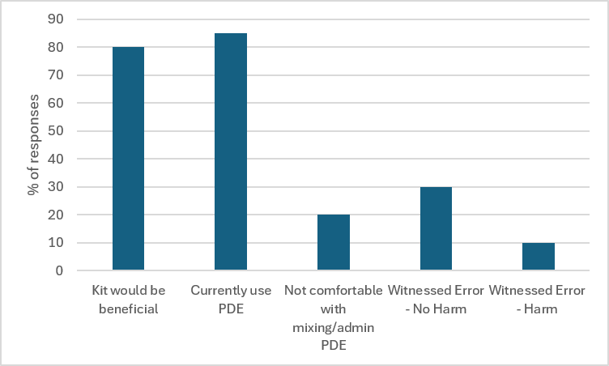
Standardizing Push-Dose Epinephrine Administration Across a Multihospital Health Network
Michael Irick, MD | Jennifer Irick, MD | Michael Ghodsi, MD | Christopher Defeo, MD
Parampreet Kaur, MD| Jaskiran Dulai, MBBS | Riley Moran, DO| John Wilson, MD
Introduction: Background & Context
Interventions/Changes
Results: Preliminary
Push-dose epinephrine (PDE) is the administration of small, rapidly delivered IV boluses of dilute epinephrine to provide immediate, short-acting hemodynamic support. This can be a temporizing intervention in critically ill patients with acute hemodynamic instability while more definitive therapies are prepared and initiated.
Our hospital network has previously lacked a standardized process for ordering and preparation of PDE. This medication is often compounded at bedside, and preparation practices vary among clinicians, resulting in inconsistent dosing and variable confidence in medication preparation and administration. Variability in compounding practices, combined with the high-acuity circumstances in which PDE is administered, may increase the risk of medication errors and adverse effects.
IRB approval granted for 1st phase of project (data acquisition through survey), with plan to resubmit to IRB for approval to review relevant charts once prefilled syringes are approved and available.
Obtained a baseline assessment of clinician confidence, administration patterns, barriers to use, and observed adverse events of PDE use through pre-intervention survey completed by clinicians throughout our hospital network. Results corroborated with an independent survey by network ED pharmacy committee.
Collaborated with pharmacy and IT to create a PDE order in the EMR, which is now actively in use.
Presented survey data at network ED Medication PI committee, with committee support to move forward with premixed PDE syringes in ED Omnicells. Awaiting final approval from network chiefs.
EMR surveillance of PDE use following implementation of prefilled syringes.
Aim/Objectives/Alignment
Discussion
Standardize and track PDE administration across SLUHN EDs through a dedicated EMR order and availability of premixed syringes of PDE in ED Omnicells.
Improve consistency and reduce errors associated with PDE administration.
Evaluate changes in clinician confidence and administration practices with pre- and post-intervention surveys.
Analyze safety and efficacy of use of prefilled PDE syringes.
  g
Critical next steps
    Obtain final approval to stock PDE in ED Omnicells from network chiefs
    Track utilization rates, efficacy, and adverse events once prefilled syringes are implemented
    Implement post intervention survey and EMR monitoring following full rollout
    Analysis of pre- and post-intervention survey data
  Limitations
    Inconsistent EMR documentation
    Manual review required therefore risk of missing data
    Difficult to identify errors or near misses
    Survey data subject to recall bias
Measures
Primary measures include change in clinician-reported confidence, practice patterns, frequency of use, and perceived errors measured by baseline and follow-up surveys
Plans to include EMR-derived metrics evaluating utilization of the standardized order and frequency of PDE administration
Comparative analysis of pre- and post-intervention survey results alongside EMR utilization metrics will demonstrate improvements in clinician confidence and practice standardization directly, while also serving as proxy indicators of error reduction and enhanced patient safety
Once pre-filled syringes are approved, track BP change pre- and 5 minutes post-administration of PDE (targeting SBP change of 25%), track utilization rates, and rates of otherwise unexplained arrhythmias post-administration
Project Alignment with Organization
Advances organizational priorities for patient safety and medication standardized care delivery
Enhances the clinical learning environment by improving clinician confidence while reducing cognitive burden during high-acuity resuscitations
NI X Meeting Three: Oct 9th, 2026

Slide 17
Guthrie Robert Packer Hospital
X + Y

Slide 18


X+Y Scheduling: Assessing Changes in Residents' Experience, Delivery and Quality of Ambulatory Care
Akshay Raut MD, Sophie Roe MPH, and Victor O. Kolade MD
Introduction: Background & Context
Residents deliver a large share of U.S. primary care, yet resident-patient quality metrics often lag attending physicians, with documented gaps in cancer screening, diabetes, and BP control.
Between-visit task completion falls on inpatient rotations
Inpatient rotations
45%
Elective rotations
68%
16%
50%
44%
of residents felt traditional scheduling minimized inpatient–outpatient conflict
of the office day in primary care is EHR/desk work: a recognized driver of burnout
of IM programs nationally have adopted X+Y rotation scheduling
Guthrie/Robert Packer Hospital Internal Medicine Residency Program implemented an “X+2” model
A fixed 2-week protected clinic block from July 1, 2025, decoupling continuity clinic from inpatient rotations

Slide 19
Aim/Objectives/Alignment
SPECIFIC
MEASURABLE
ATTAINABLE
Effect of X+2 on 7 workload metrics, 5 quality metrics, and ACGME burnout/satisfaction in RPH IM PGY-2 & PGY-3 residents
Adjusted regression coefficients (min/day), pre/post quality rates (%), run-chart sustained-shift rule, annual survey %
Uses departmental data already collected for institutional quality/operational reporting; no new data-collection burden
RELEVANT
TIMELY
INCLUSIVE & EQUITABLE
Ambulatory quality and resident wellbeing are core indicators of continuity-clinic effectiveness and training quality
Bounded observation window March 2025 to June 2026; intervention started from July 1, 2025
Cohort-level rates pool numerators/denominators across residents (avoids Simpson's-paradox bias); resident-identifying data removed
Supports Guthrie's population-health quality priorities (preventive screening, diabetes control, AWV completion), ACGME program-accreditation goals (resident wellbeing/burnout), and a national SGIM/ACLGIM effort to redesign continuity clinic around protected ambulatory time.
ALIGNMENT

Slide 20
Measures
Aim | Data source | Measures | Analysis
Primary Aim Workload/ Efficiency | Epic Signals | 7 metrics: Ambulatory & Inpatient Time in Epic, Ambulatory & Inpatient Clinical Review, In-Basket Turnaround, Pajama Time, Time Outside Scheduled Hours | Multivariable OLS: metric ~ clinic-fraction + inpatient-fraction + post-indicator (isolates X+Y effect)
Secondary Aim Ambulatory Quality | Monthly Population Health Compliance Reports | Diabetic Bundle, Colorectal Cancer Screening, Medicare AWV, Depression Screening, Pneumococcal Vaccination | Welch's t-test + run-chart sustained-shift rule (≥6 consecutive points past pre-median)
Tertiary Aim Resident Wellbeing | ACGME Resident Survey | % reporting burnout; % overall positive program rating | Descriptive trend (3 annual points)

Slide 21
Interventions/Changes
The Core Intervention
X+2 Ambulatory Block Scheduling, live July 1, 2025: Y = fixed 2-week clinic block with a full continuity panel and minimal inpatient competition; X = non-clinic block (inpatient/ICU/other), with panels covered by residents currently in a Y block
Intent: protect ambulatory time, improve continuity, and concentrate rather than fragment clinic documentation and follow-up
Implementation & Evaluation Methodology
IRB Submission & Approval: Protocol dated Sept 13, 2025; waiver of consent + HIPAA authorization; cohort-level de-identified data only
Evaluation Design: Retrospective pre/post with a schedule-adjusted multivariable model chosen specifically to break the rotation-mix confounding
Extended Follow-up through June 2026 (a full academic year) built in by design
Short-term vs. Long-term Solutions/Prioritization
Horizon | Actions (prioritized)
Short-term | Continue X+2; stand up Epic Signals + Population Health quality dashboards for the resident cohort; verify resident–clinician name matching
Near-term | Component-level tracking of Diabetic Bundle to localize drivers; run-chart monitoring for sustained shifts
Long-term | Add protocol's faculty / Guthrie Lourdes comparators and non-resident quality comparator; add continuity-of-care indices; consider spread to other IM sites

Slide 22
Barriers & Strategies
Barrier encountered | Strategy applied
Confounding: X+Y went live with a new block schedule — pre/post alone can't separate the two | Built weekly rotation-mix covariates from actual schedules; modeled the X+Y effect holding rotation mix constant
Misleading early signal: unadjusted data (through Feb 2026) suggested an in-basket improvement | Extended follow-up + schedule adjustment; signal did not replicate (p=0.362) → not claimed as an effect
Short pre-period for workload (~4 months, Epic Signals availability) | Cross-checked regression vs. simple pre/post means for face validity; flagged as a power limitation
Denominator instability: mid-period change in Pneumococcal eligibility criteria | Did not attribute the decline to X+Y; flagged for chart-level re-review with a stable denominator
Unavailable comparators: faculty, Guthrie Lourdes, non-resident clinician groups; 4 named ACGME items | Restricted scope transparently to resident cohort; used 2 aggregate ACGME figures as a descriptive proxy
Name-matching risk (schedule ↔ Epic) | Manual verification of resident-to-clinician matches
No packaged stats library in analysis environment | Implemented matrix least squares (heteroscedasticity-naive SEs, Wald t-tests) directly
Small wellbeing sample (3 annual points) | Descriptive trend only; explicitly labeled hypothesis-generating

Slide 23
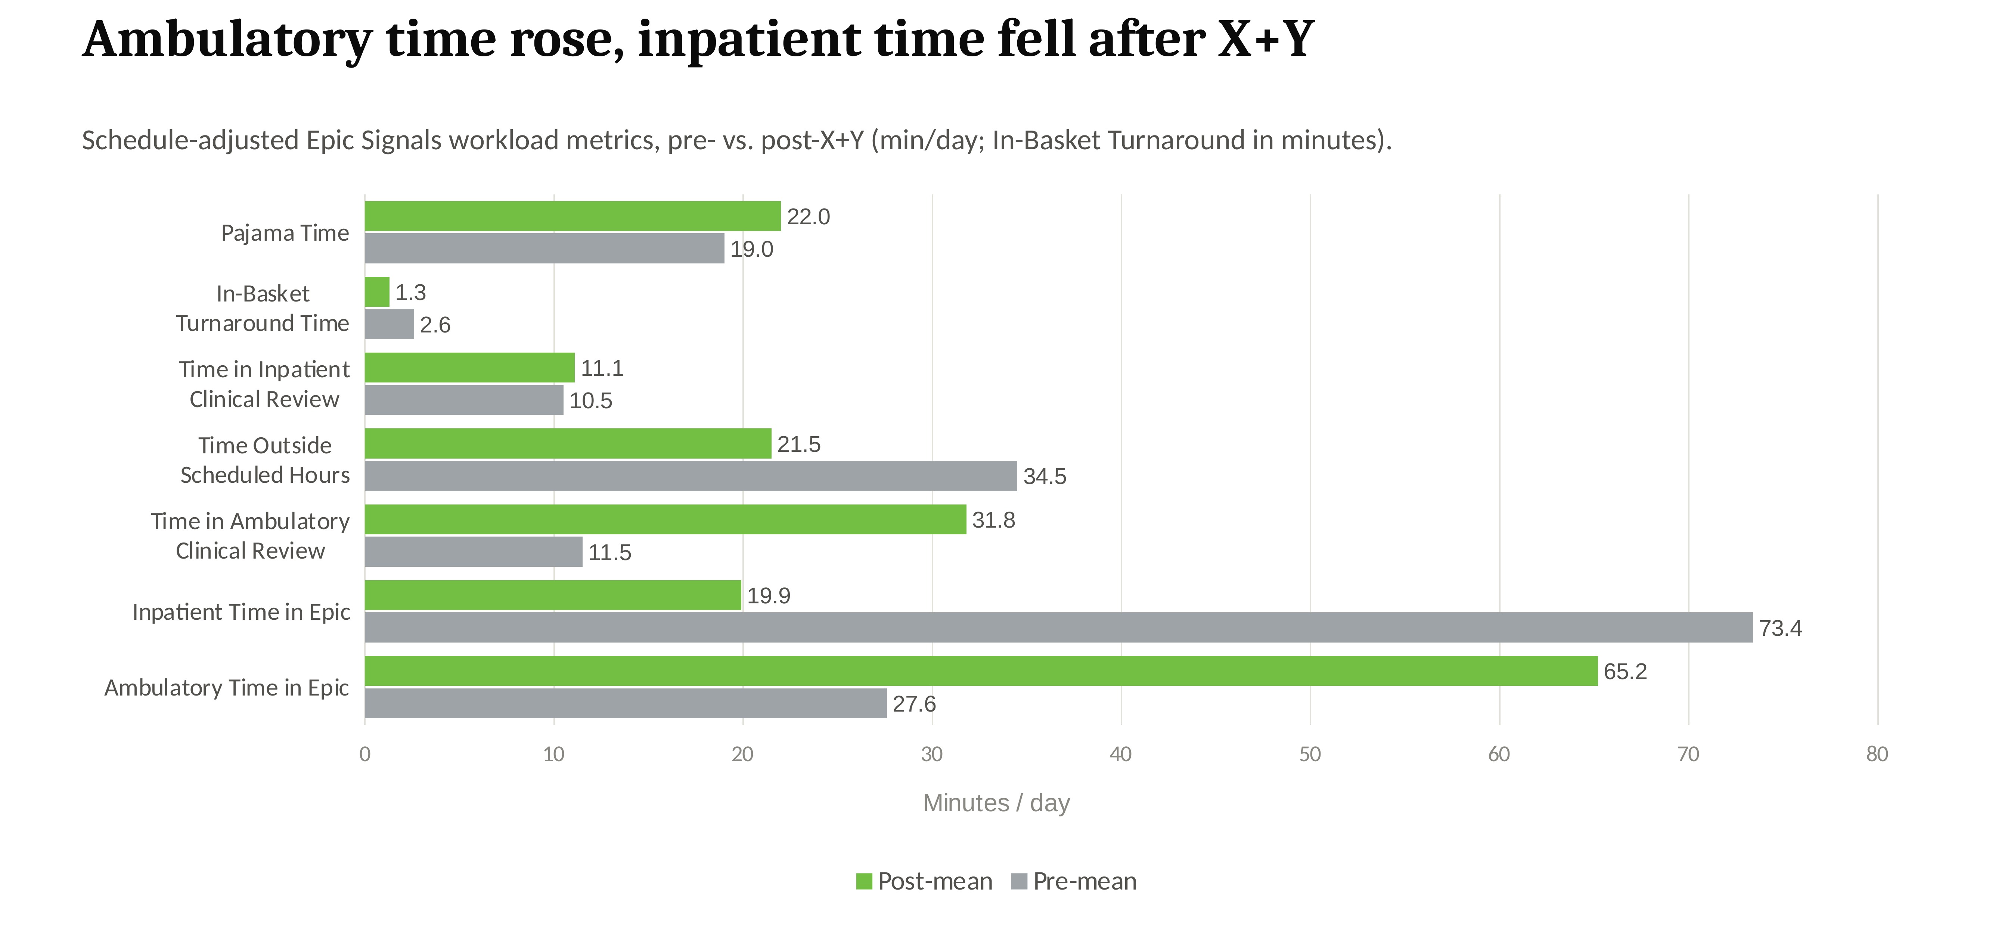
Results
After X+Y, residents shifted roughly 38 more min/day into ambulatory documentation and 54 fewer min/day into inpatient work, the largest changes are in exactly the two metrics the model targeted

Slide 24
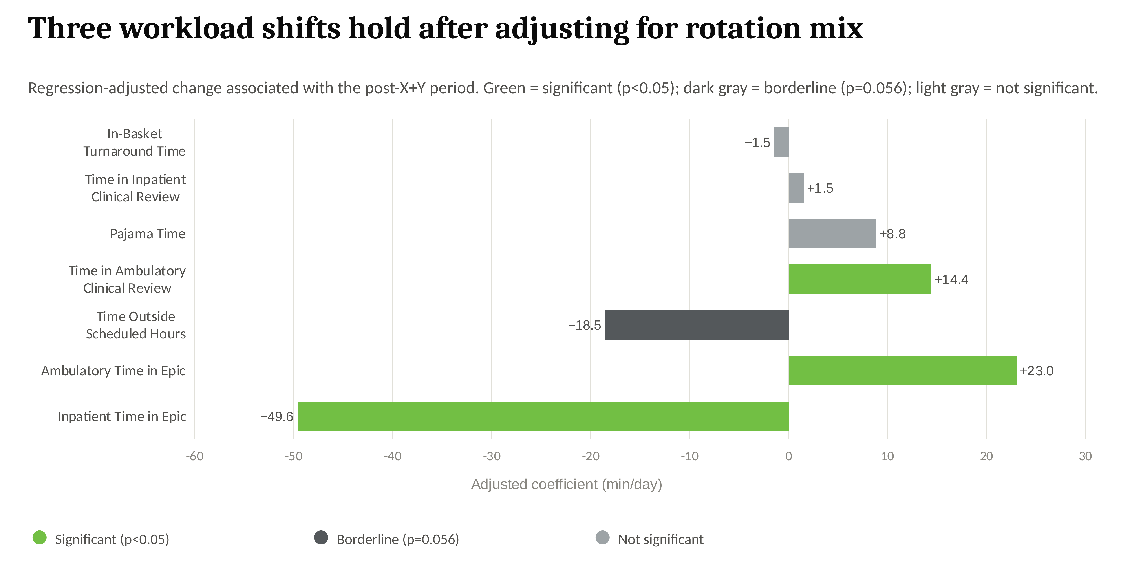
Results
Controlling for how much of each week was clinic vs. inpatient, three shifts stay statistically real: more ambulatory time, less inpatient time, and more ambulatory chart review; the rest are not distinguishable from chance

Slide 25
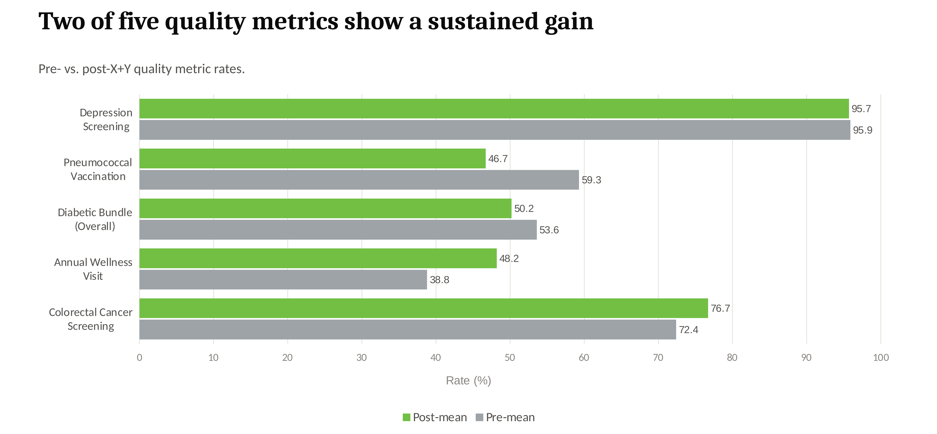
Results
Colorectal Cancer Screening and Annual Wellness Visit improved and held; Depression Screening stayed flat near ceiling, while Diabetic Bundle and Pneumococcal Vaccination slipped slightly: a mixed, not uniform, quality picture

Slide 26
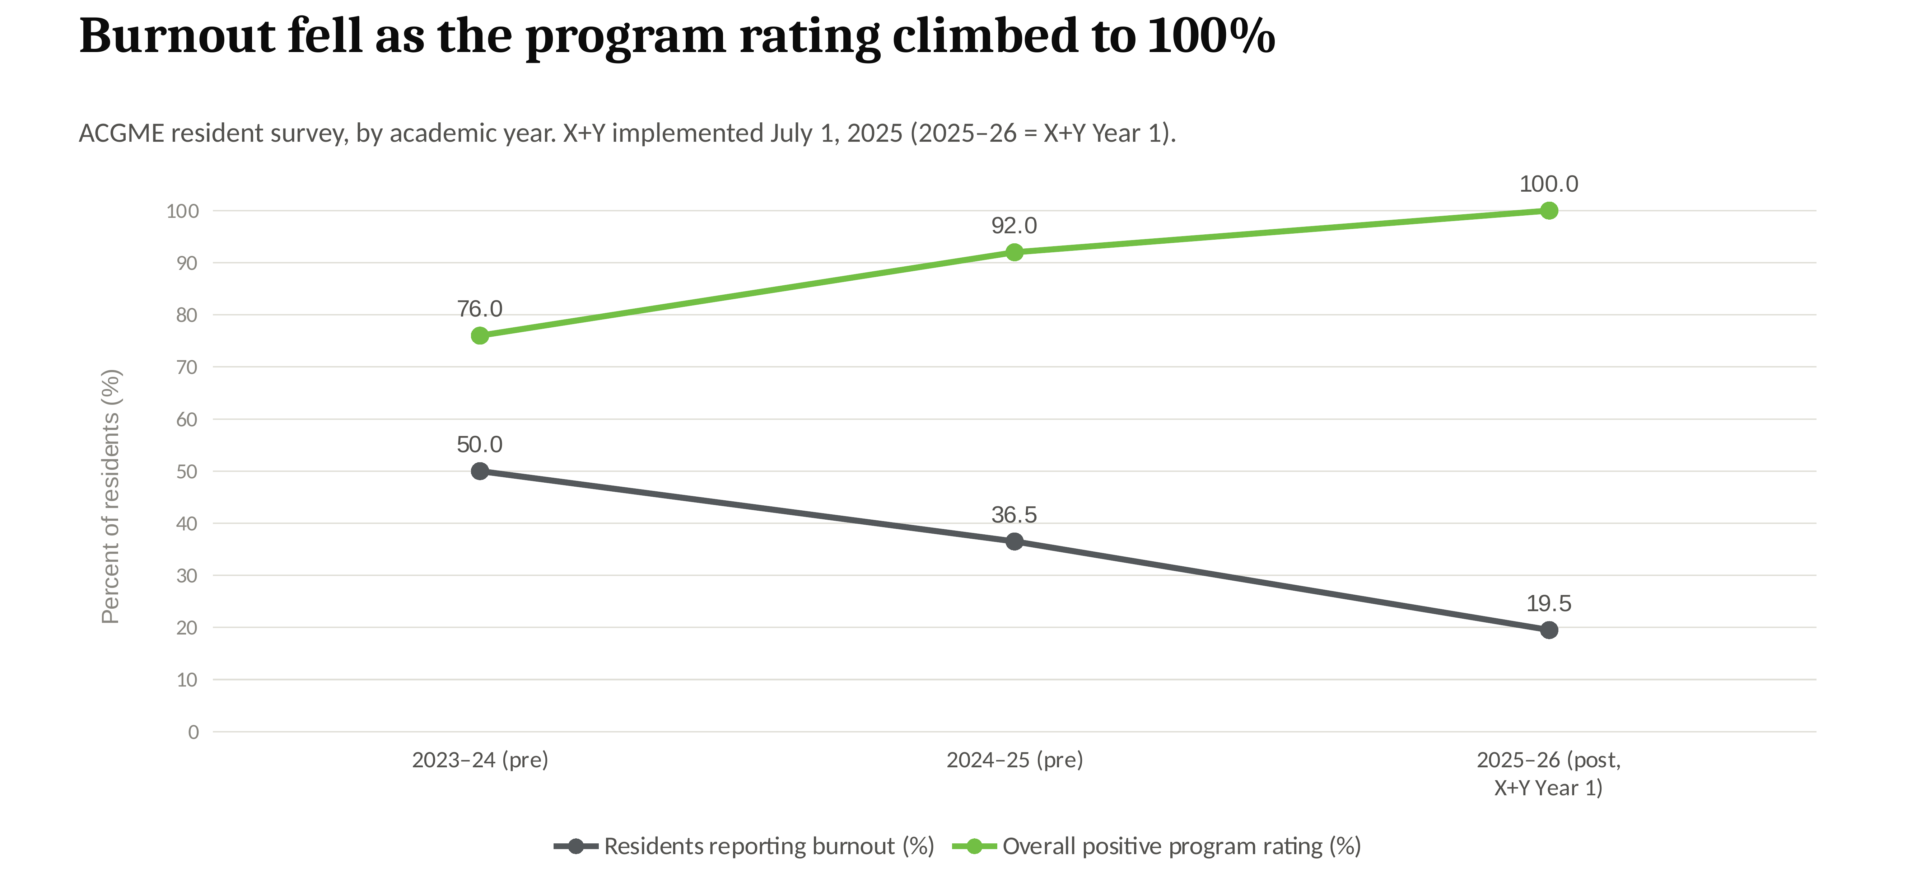
Results
Self-reported burnout fell by more than half over two years while overall program rating climbed to 100%, an encouraging trend, though based on only three annual survey points

Slide 27
Guthrie Robert Packer Hospital
Inbasket

Slide 28
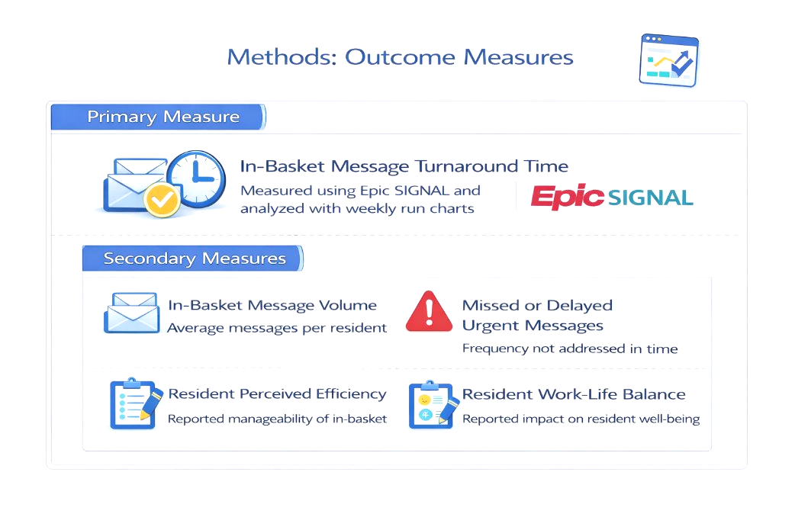

Rewiring the Workflow: Optimizing the Clinical Learning Environment through Epic® In-Basket Management in IM Resident Clinic
Ifeoluwa Mary Anighoro MD, Mubashir Abbas MD, Ayush Adhikari MD, FNU Arundhati MD, Shubhendu Bajpai MD, Sahil Grover MD, Jiss Joy MD, Sheeza Nawaz MD, Tanya Ratnani MD, Ashraf Ullah MD, Ismaila Yusuf MD, Hina Zubair MD, Victor Kolade MD, John Pamula MD
Introduction: Background & Context
Interventions/Changes
Results: Preliminary
Our program transitioned from a traditional schedule to an X+Y scheduling system, alternating dedicated inpatient and outpatient blocks.
During inpatient blocks, residents continued to receive patient messages, test results, and other in-basket tasks. With limited time to address these during busy clinical rotations, messages accumulated and the workload increased.
To address this, we assigned one resident on an outpatient block to manage the in-baskets of all residents on busy rotations.
In-Basket Workflow Redesign: A Five-Part Intervention
In-Basket Median Turnaround Time (hours) by Message Type: Pre-intervention vs PDSA-1 vs PDSA-2
ELIMINATE
Remove low-value messages: turn off automatic ADT/FYI alerts; 90-day refills; optimized after-visit summaries.
AUTOMATE
Embed protocols for routine tasks: automated chronic-refill protocols; templated responses; PDMP integration.
DELEGATE
Team-based in-basket management: administrative pool run by patient liaison/PSR; random safety-team audits.
COLLABORATE
Shared coverage system: team-based coverage during time off; coverage pools; “empty inbox” policy before vacation.
AI ENHANCEMENT
Integration of Regard AI software to support automation and in-basket message triage.
PDSA-2 Reduction in Median Turnaround Time
Message type | Results | Patient Calls | eGuthrie Medical Advice Request | Rx Response | Rx Authorization
vs PDSA-1 | −16% | −35% | −22% | −69% | −60%
vs Pre-intervention | −37% | −71% | −76% | −95% | −76%
Aim/Objectives/Alignment
Measures
Primary aim: Reduce time spent managing Epic® in-basket messages.
Workflow: Improve prioritization, remove low-value notifications, and strengthen cross-coverage.
Safety & well-being: Reduce missed urgent messages and improve resident satisfaction.
Organizational impact: Support patient safety, timely care, provider well-being, and operational efficiency.
Discussion
Critical Next Steps
1. Complete PDSA Cycle 2 and audit missed/delayed critical results.
2. Assess resident well-being and compare PGY-1 to PGY-3 outcomes.
B. Project Status
1 Cycle 1: Completed | Cycle 2: In progress, ~6 months elapsed.
C. Areas for Guidance
1 Optimize in-basket configuration and reduce message noise.
2 Benchmark metrics and evaluate AI-assisted triage.
3 Address Cycle 2 trends and ensure medicolegal compliance.
Project Alignment with Organization
Supports patient safety, timely care, and provider well-being.
Improves EHR workflow and operational efficiency.
Promotes resident-led quality improvement and innovation.
Barriers: High message volume, workflow resistance, and unclear cross-coverage ownership.
Cycle 2 signal: Increased message volume and delayed critical results; causes under review.
Strategies: Reduce low-value alerts, clarify roles, provide training, and monitor progress.

Slide 29
Introduction: Background & Context
Widespread adoption of electronic health records (EHRs), including Epic®, has markedly increased the volume of in-basket messages managed by residents.
High message volume contributes to administrative burden, delayed communication, and resident burnout.
Resident in-baskets are frequently cluttered with addressed, low-value, or non-actionable messages, limiting visibility of urgent and unresolved items especially during cross-coverage.
Inefficient in-basket workflows pose risks to patient safety, delay care delivery, and negatively impact patient satisfaction.

Slide 30
Aim/Objectives/Alignment
Primary aim: reduce time to address Epic® in-basket messages among Internal Medicine Residents through improved message prioritization, elimination of low-value notifications, and cross-coverage efficiency.
Secondary objectives: prevent missed or delayed urgent messages; improve resident satisfaction and work-life balance.
Address Alignment: this project supports the hospital’s priorities of patient safety, care timeliness, and operational efficiency, and demonstrates the residency program’s value through resident-led quality improvement.
Project Alignment with Organization:
Supports the hospital’s priorities of improving patient safety, care timeliness, provider well-being, and operational efficiency.
Demonstrates the residency program’s value by leveraging resident-led quality improvement to address system-level inefficiencies within the EHR.
Positions residents as key drivers of innovation, safety, and workflow optimization aligned with the hospital’s strategic goals for high-quality, sustainable care delivery.

Slide 31
Measures
Primary: In-Basket Message Turnaround Time - target <24h for urgent, <48h for routine messages; measured via Epic timestamps and weekly Epic SIGNAL run charts.
In-Basket message volume per resident per day - tracked via daily AM/PM shift logs; target: reduction from baseline.
Missed critical results/delayed medication refills - target: zero missed critical messages.
Resident provider satisfaction - burnout assessment and work-life balance, via resident surveys; target: 2.5% improvement.
Team workload distribution - staff overtime hours, message-handling time; target: maintain current levels despite volume increase.
Patient access measures - time to appointment availability, call abandonment rate; target: no degradation in access.

Slide 32
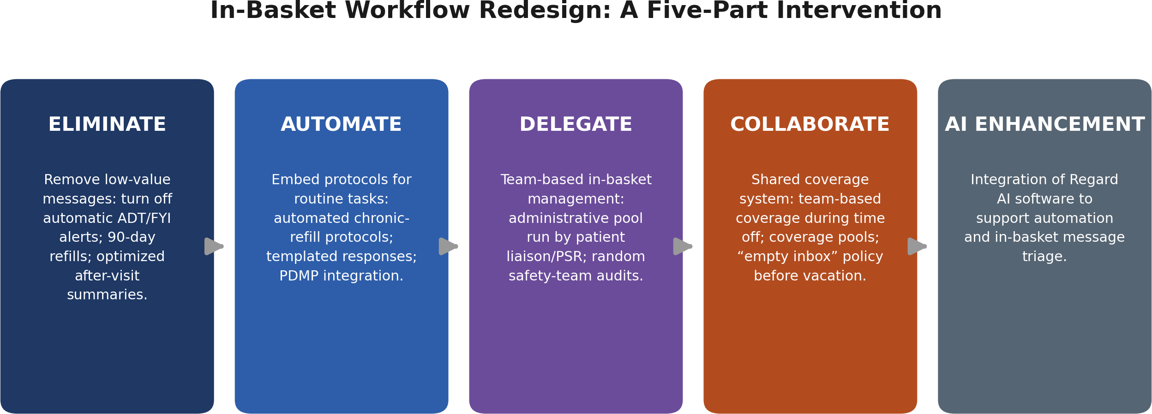
Interventions/Changes

Slide 33
Barriers & Strategies
Key barriers: high baseline message volume, resistance to adopting new inbox workflows, and ambiguity around message ownership during cross-coverage.
New signal from Cycle 2 data to date: early rise in message volume and in missed/delayed critical results; possible contributors under review include new PGY-1 onboarding in July, transition to new coverage pools, and the Regard AI rollout learning curve - root cause not yet confirmed.
Strategies: prioritizing elimination of low-value notifications, establishing clearly defined team-based roles, and providing targeted training for residents and support staff.
Continuous monitoring with feedback loops will support sustained adoption and iterative improvement.

Slide 34
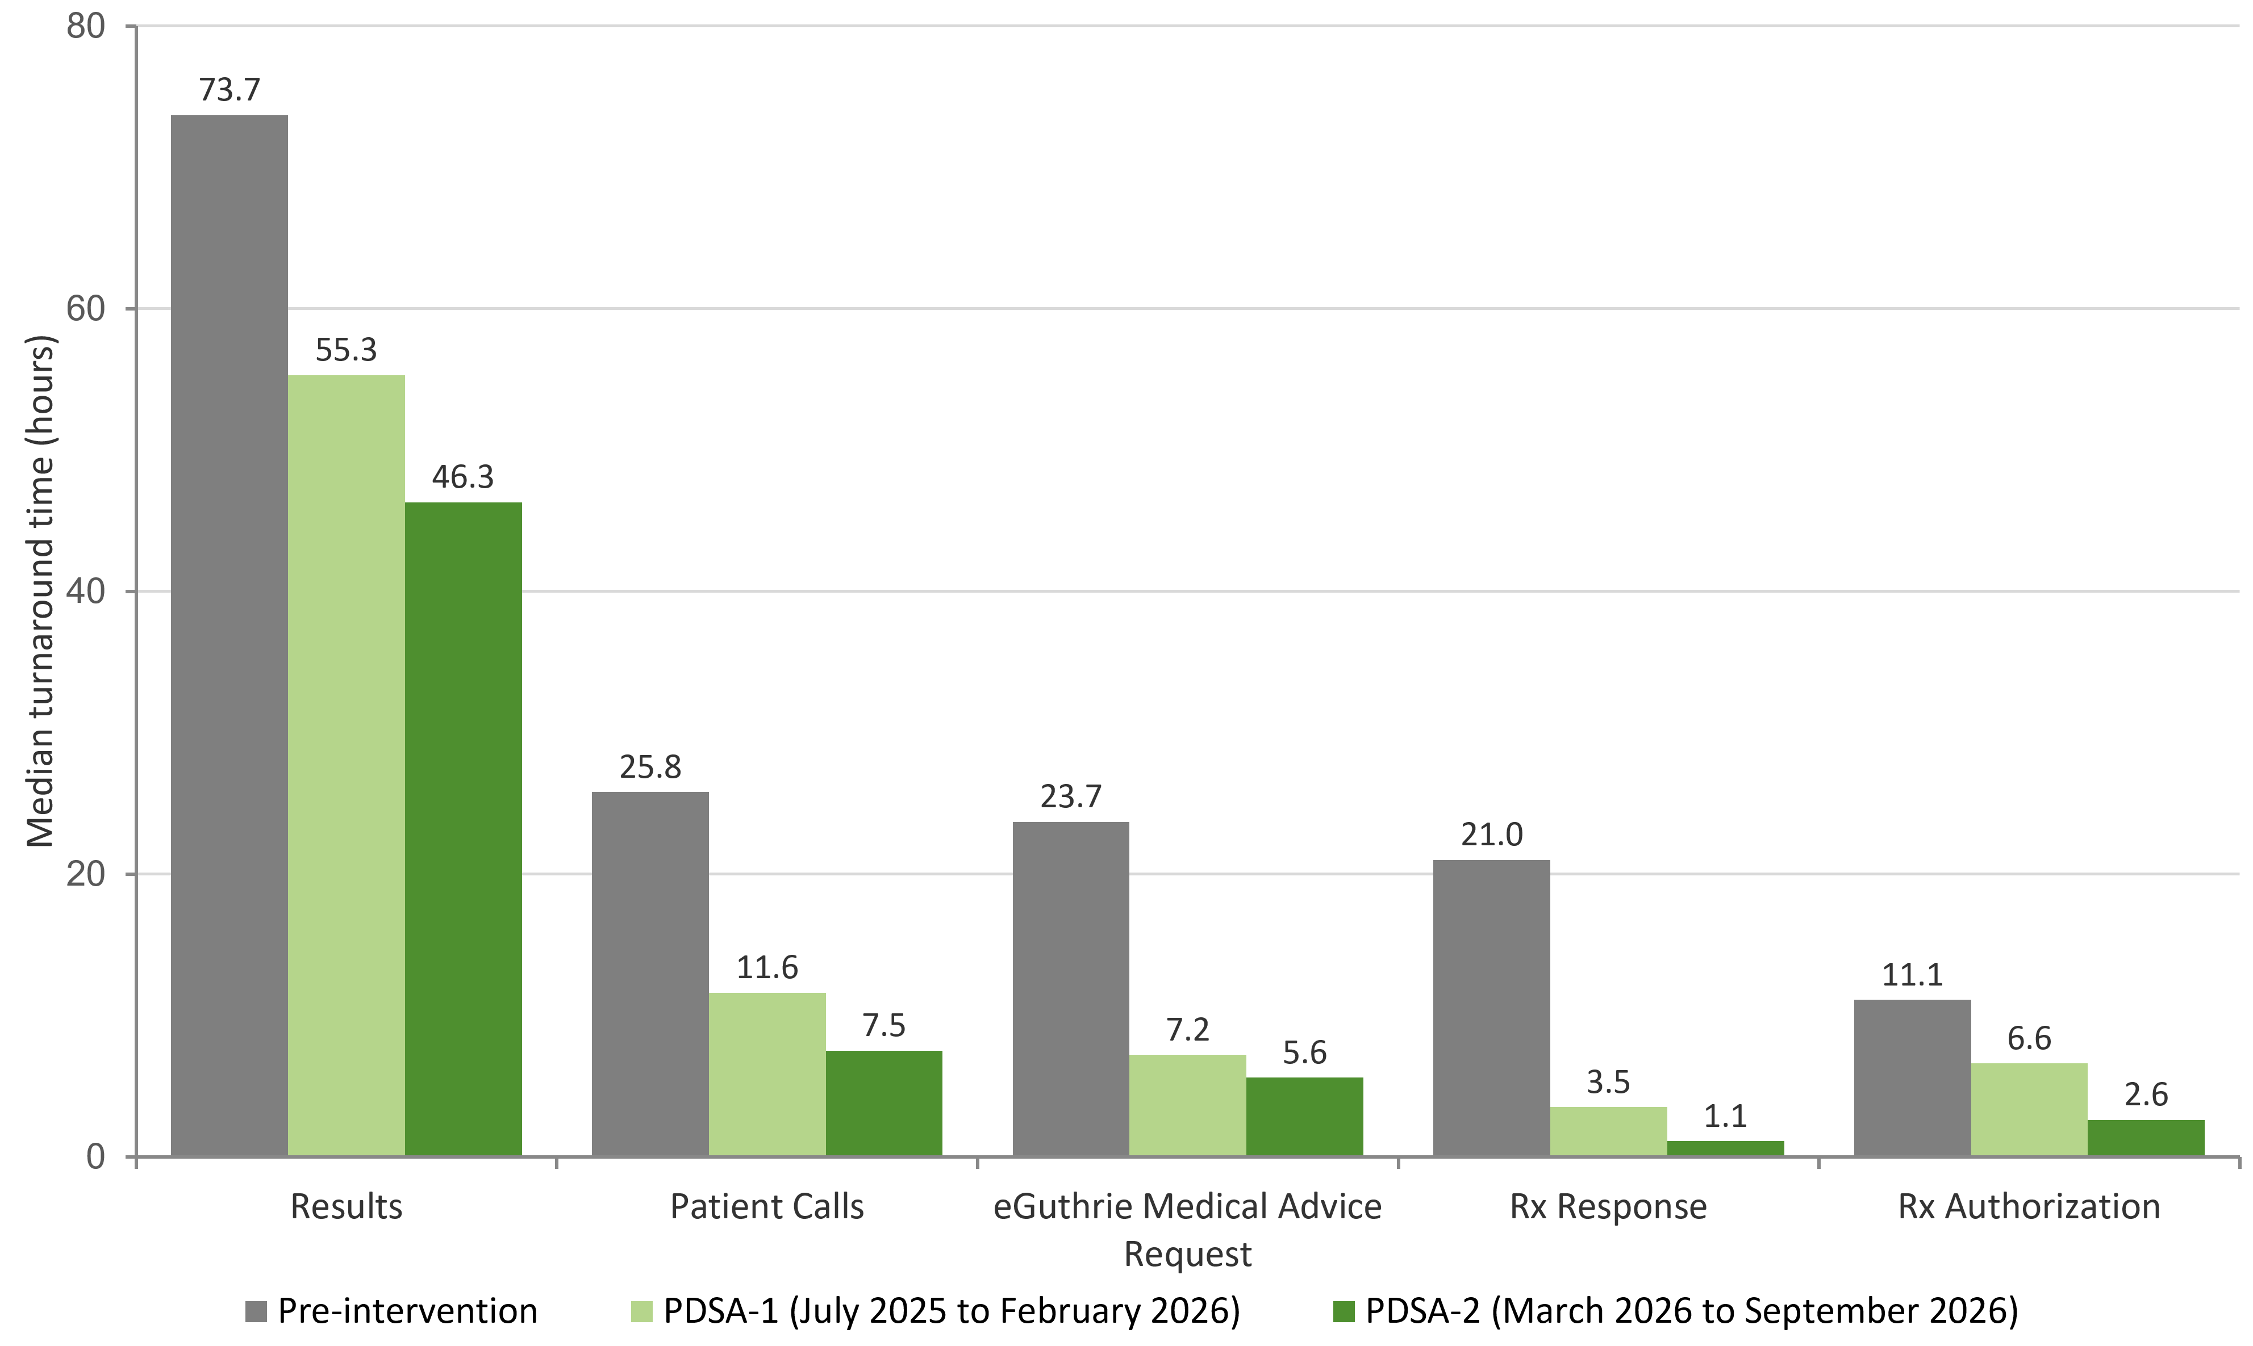
Results: Preliminary
In-Basket Turnaround Time by Message Type: PDSA-1 vs PDSA-2
Median turnaround time (hours), Residents in-basket data (Epic Signal)
PDSA-2 Change in Resident In-Basket Median Turnover Time
Results
− 16% reduction vs PDSA-1
− 37% reduction vs pre-intervention
Patient Calls
− 35% reduction vs PDSA-1
− 71% reduction vs pre-intervention
eGuthrie Medical Advice Request
− 22% reduction vs PDSA-1
− 76% reduction vs pre-intervention
Rx Response
− 69% reduction vs PDSA-1
− 95% reduction vs pre-intervention
Rx Authorization
− 60% reduction vs PDSA-1
− 76% reduction vs pre-intervention

Slide 35
Discussion
Critical Next Steps:
Complete PDSA Cycle 2 (Mar 2026-Mar 2027).
Conduct a root-cause audit of the missed/delayed critical results identified in Cycle 2 to date.
Collect the resident well-being survey at the end of PDSA Cycle 2 and analyze results.
Compile PGY-1 to PGY-3 results after Cycle 2 to compare annual data.
Project Status:
PDSA Cycle 1 completed (Jul 2025–Feb 2026). PDSA Cycle 2 in progress (Mar 2026–Mar 2027, ~6 months elapsed).
Areas for Guidance/Input:
Advanced in-basket configuration and signal-to-noise reduction.
Benchmarking inbox metrics against peer institutions.
Safe, effective integration of AI-assisted triage (Regard AI) and automation tools.
Interpreting the early Cycle 2 rise in message volume and missed critical results.
Compliance with medicolegal standards and documentation requirements.

Slide 36
Guthrie Robert Packer Hospital
Resident Education- Alcohol

Slide 37

REACH-AUD: Resident Education and Alcohol Care in Healthcare
Kamron Hamedi, MD; Victor Kolade, MD
Introduction: Background & Context
Alcohol Use Disorder (AUD) has a national prevalence of 10% in patients 12 and older¹
Rural communities disproportionately affected²
Responsible for $249 Billion in healthcare costs and other financial losses including legal costs and destruction of property³
Annually costs $31 Billion due to liver disease and, $15.3 Billion in emergency costs, and $93 Billion in hospital costs^{4,5}
Alcohol use contributes to substantial morbidity, including liver disease, cardiovascular disease, injury, and psychiatric illness6,7
Accounts for 5% of all deaths annually and has a mortality rate of approximately 29%8

Slide 38
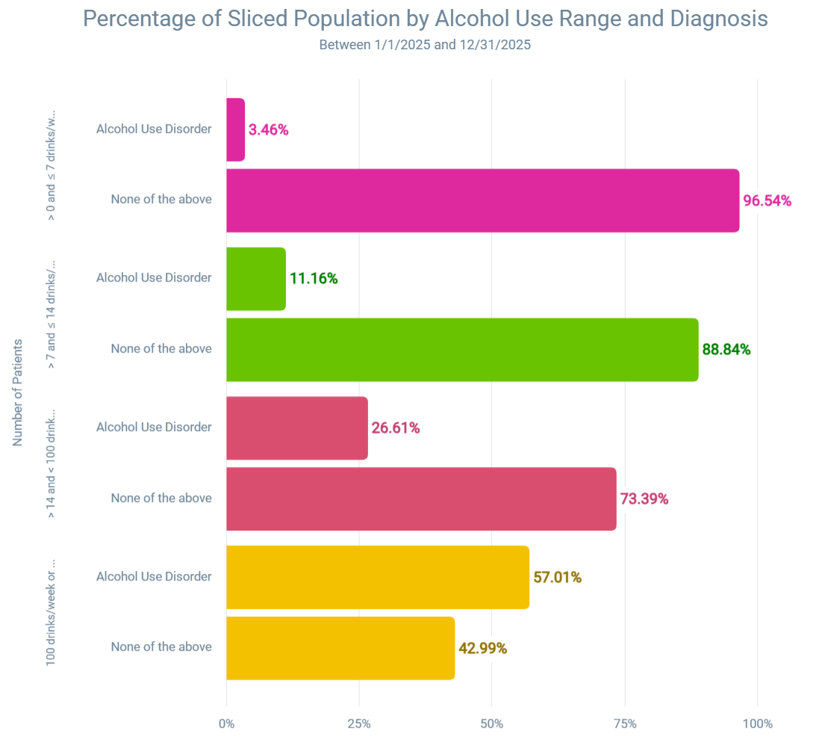
Aim/Objectives/Alignment

Slide 39
Aim/Objectives/Alignment
  Our goal is to improve resident education, identification, and treatment of alcohol use disorder. We plan for at least a 10% improvement in reported resident familiarity and at least a 5% increase in alcohol use screening documentation within 3 months of education.

Slide 40
Measures
Residents will take a pre-education survey, immediate post-education survey, and 1 month post-education survey
AUDIT-C and Cage screening tools will be audited for patients with identified alcohol use >15 drinks per week
Notes of the above patients will be audited for documentation of screening and treatment

Slide 41
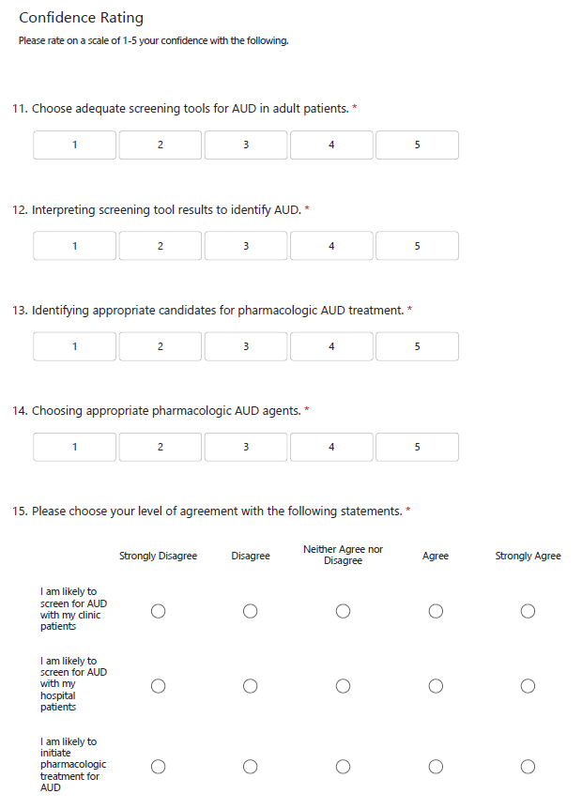
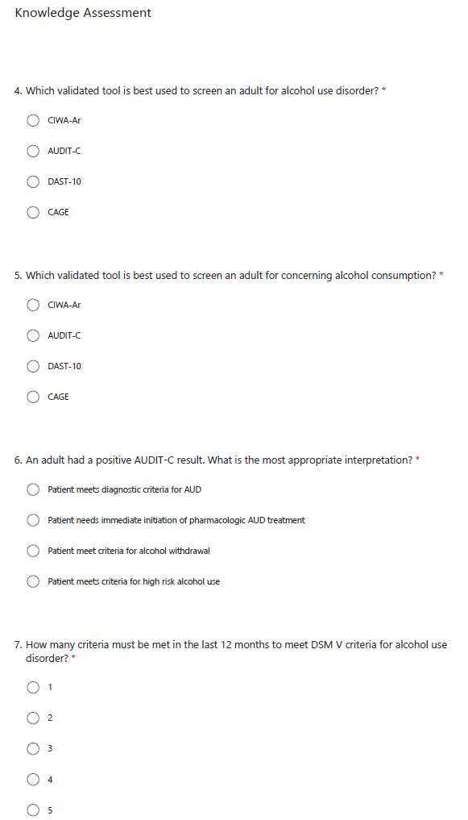
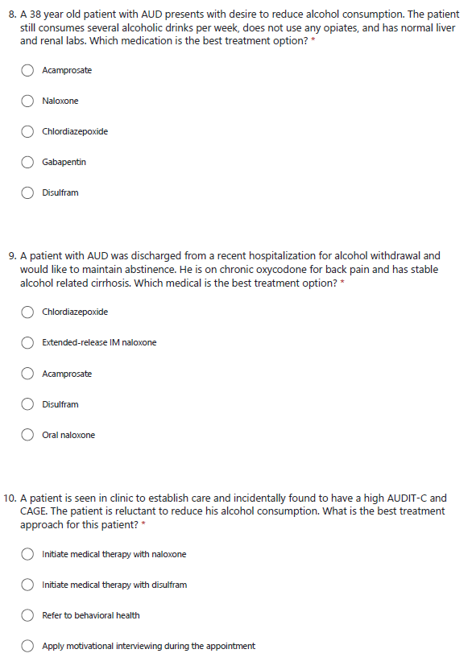
Interventions/Changes

Slide 42
Interventions/Changes
Educational noon conference for residents
Use of pre-, post- and 1 month post-educational survey
Introduction of formal AUDIT-C and CAGE screening tools in EPIC
Creation of EPIC flag if >15 weekly drinks or AUDIT-C >3 to prompt CAGE screen and use of AUD order set
Creation of AUD order set to streamline laboratory testing, consultations, and medications

Slide 43
Barriers & Strategies
Screening is often done by nursing in clinic
EPIC flags and order set would be available for more than just residents
  We have involved multidisciplinary discussion from multiple service lines and departments
Patients can refuse treatment if not interested
  The AUD order set will include a patient refused care option
  EPIC flag will be silenced for a period of time after order set is used

Slide 44
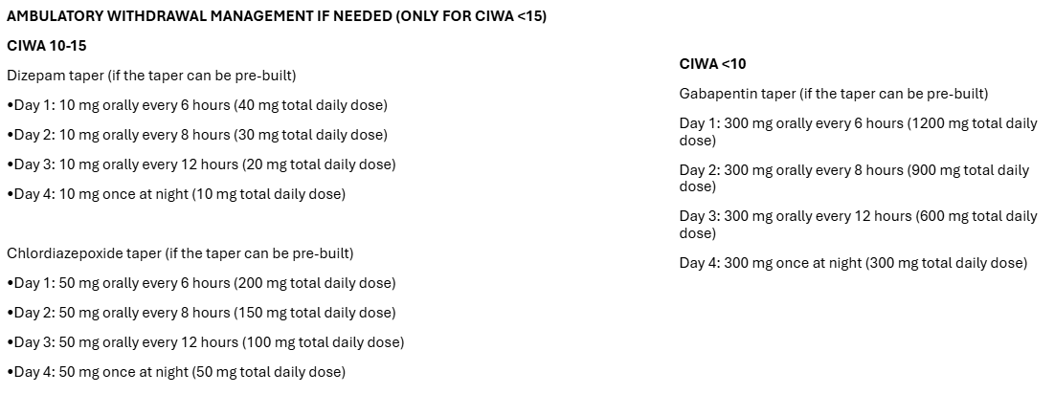
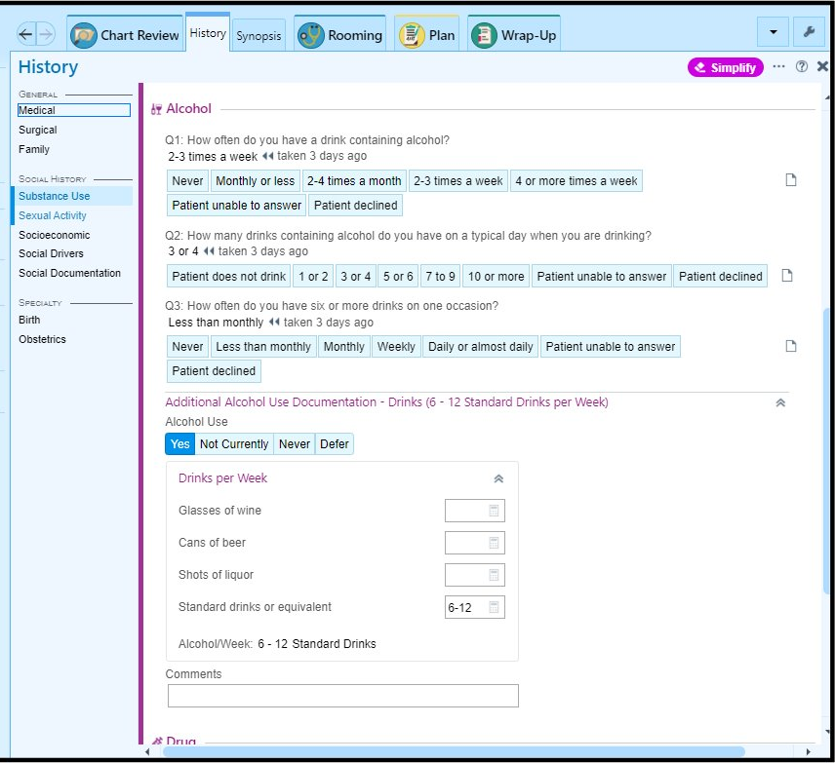
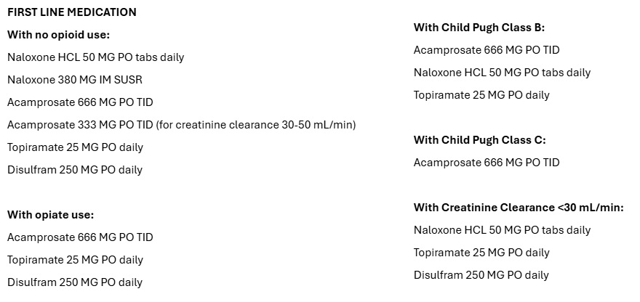
Results

Slide 45
Discussion
We are still in process of getting final approval for inclusion of AUDIT-C and CAGE screening tools
Working on approval for order set
There is a large potential for benefit to the community
Can directly address identified gap in resident education
Bailey AJ, Quinn PD, McHugh RK. Implications of the shift to DSM-5 for alcohol use disorder prevalence estimates in the National Survey on Drug Use and Health. Addiction. 2025;120(1):184-188. doi:10.1111/add.16670.
Borders TF, Booth BM. Rural, suburban, and urban variations in alcohol consumption in the United States: findings from the National Epidemiologic Survey on Alcohol and Related Conditions. J Rural Health. 2007;23(4):314-321.
Sacks JJ, Gonzales KR, Bouchery EE, Tomedi LE, Brewer RD. 2010 national and state costs of excessive alcohol consumption. Am J Prev Med. 2015;49(5):e73-e79. doi:10.1016/j.amepre.2015.05.031.
Julien J, Ayer T, Tapper EB, Chhatwal J. The rising costs of alcohol-associated liver disease in the United States. Am J Gastroenterol. 2024;119(2):270-277. doi:10.14309/ajg.0000000000002405.
White AM, Slater ME, Ng G, Hingson R, Breslow R. Trends in alcohol-related emergency department visits in the United States: results from the Nationwide Emergency Department Sample, 2006 to 2014. Alcohol Clin Exp Res. 2018;42(2):352-359. doi:10.1111/acer.13559.
Rehm J, et al. Dose-response relationships between levels of alcohol use and risks of mortality or disease, for all people, by age, sex, and specific risk factors. Nutrients. 2021;13(8):2652. doi:10.3390/nu13082652.
Lai HMX, Cleary M, Sitharthan T, Hunt GE. Prevalence of comorbid substance use, anxiety and mood disorders in epidemiological surveys, 1990–2014: a systematic review and meta-analysis. Drug Alcohol Depend. 2015;154:1-13.
Vaillant GE, Clark W, Cyrus C, et al. Prospective study of alcoholism treatment: Eight-year follow-up. Am J Med. 1983;75(3):455-463. doi:10.1016/0002-9343(83)90349-2.

Slide 46
Guthrie Robert Packer Hospital
Tradition to Transformation

Slide 47

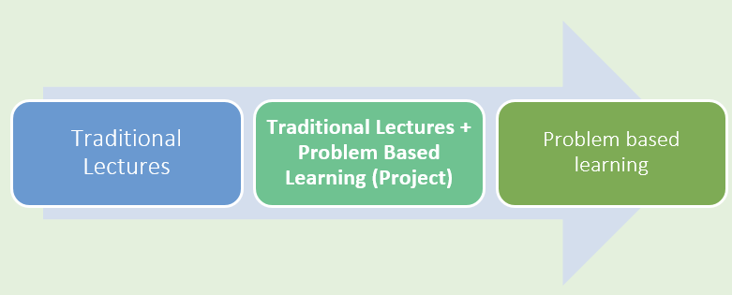
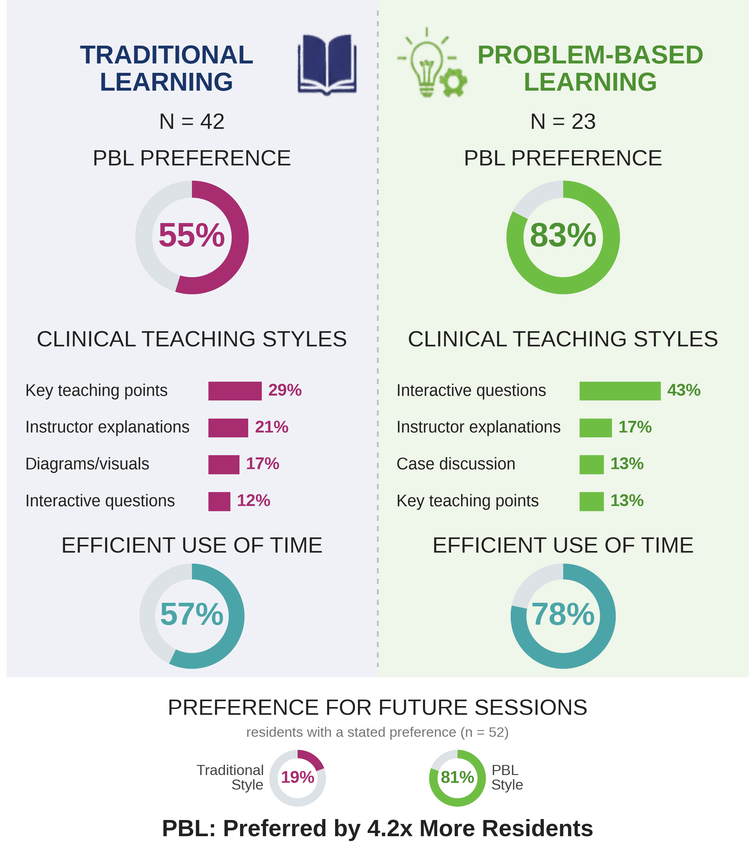
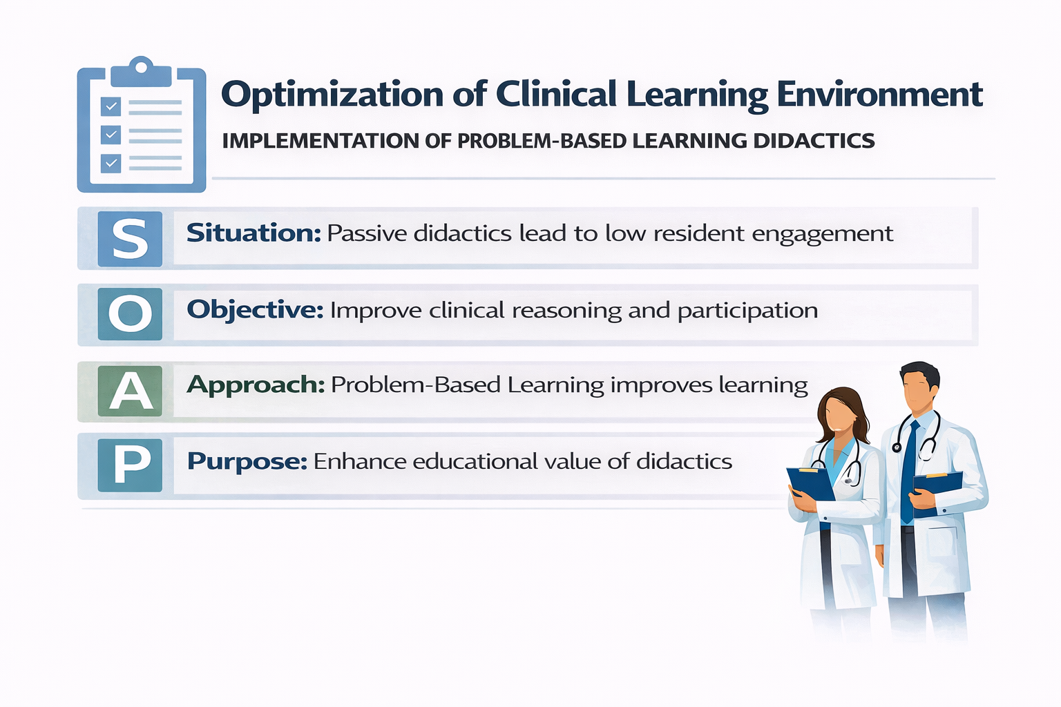
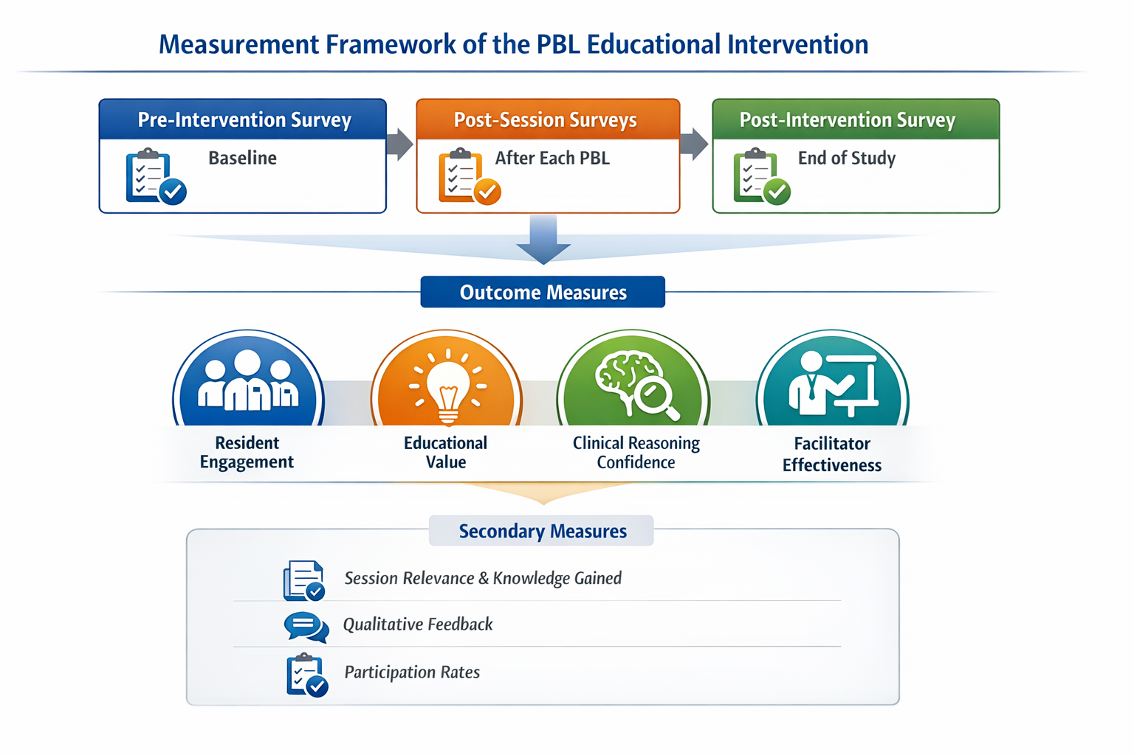
From Tradition to Transformation: Using Problem-Based Learning to Shape the Clinical Learning Environment in a Rural Academic Medical Center
Ifeoluwa Mary Anighoro MD, Mubashir Abbas MD, Ayush Adhikari MD, FNU Arundhati MD, Shubhendu Bajpai MD, Sahil Grover MD, Jiss Joy MD, Sheeza Nawaz MD, Tanya Ratnani MD, Ashraf Ullah MD, Ismaila Yusuf MD, Hina Zubair MD, Victor Kolade MD, John Pamula MD
NI X Meeting Three October 9, 2026
Introduction: Background & Context
Interventions/Changes
Results: Preliminary
Traditional didactics rely on passive learning, limiting engagement and clinical reasoning, especially in rural residencies with limited faculty and competing clinical demands.
Problem-Based Learning (PBL) is an evidence-based, active approach to clinical reasoning that remains under-utilized in residency curricula.
Aim/Objectives/Alignment
Design: Prospective QI project in a rural IM residency
Intervention: PBL replaced 1 weekly didactic and 1 teaching round; remaining sessions served as controls
Format: 60-minute case-based sessions with progressive triggers and guided discussion
Facilitator Training: 1-hour workshop with standardized case templates
Evaluation: Pre-intervention, post-session, and post-intervention Likert surveys plus qualitative feedback.
Measures
Project alignment with organization
Advances high-quality patient care, safety, and evidence-based practice by strengthening resident clinical reasoning and decision-making.
Elevates academic standards and demonstrates the Residency Program's value as a driver of quality improvement through a structured, evidence-based teaching model aligned with the hospital's academic mission.
Discussion
Current State: PDSA Cycle 1 ran August 2025 to February 2026; Cycle 2 began March 2026 and ends March 2027
Next Steps: Complete Cycle 2 surveys, analyze results, and compare annual data across both cycles
Guidance Needed: Curriculum integration and sustainability, aligning cases with the ABIM Blueprint, lessons from similar active learning initiatives, and collaboration opportunities
Barriers and Strategies
Limited protected time, competing clinical demands, and resistance to change, addressed with facilitator training, standardized case templates, and workflow-aligned content.
NI X Meeting Three: October 9, 2026​

Slide 48

Introduction: Background & Context
Traditional lecture-based didactics and teaching rounds rely heavily on passive learning and are associated with lower engagement and limited clinical reasoning development.
These limitations are further amplified in rural community-based academic residency programs due to constrained faculty resources and competing clinical demands.
Problem-Based Learning (PBL) is an evidence-based, learner-centered approach that promotes active engagement and clinical reasoning but remains under-utilized in residency education curriculum.
Traditional lecture-based didactics
Passive
Learning
Problem-Based
Learning
Lower engagement
and limited clinical
reasoning development
NI X Meeting Three: October 9, 2026
Problem-Based Learning Quality Improvement Project

Slide 49
Aim/Objectives/Alignment
Project Alignment with Organization
Advances the Organization’s commitment to high-quality patient care by strengthening resident clinical reasoning and decision-making, directly supporting patient safety and evidence-based practice.
Elevates the Organization’s Academic Standards by implementing a structured, evidence-based educational model that enhances the quality and consistency of inpatient teaching.
Demonstrates the Residency Program’s value as a driver of quality improvement, using innovative, structured educational interventions aligned with the hospital’s academic mission.
NI X Meeting Three: October 9, 2026
Problem-Based Learning Quality Improvement Project

Slide 50
Measures
NI X Meeting Three: October 9, 2026
Problem-Based Learning Quality Improvement Project

Slide 51
Interventions/Changes
Design: Prospective Quality Improvement project in a rural IM residency program.
Intervention: Replaced 1 weekly didactic + 1 weekly teaching round with structured Problem-Based Learning (PBL); remaining sessions served as traditional control.
Format: 60-minute case-based sessions using progressive clinical triggers, guided discussion, and evidence-based takeaways.
Facilitator Training: 1-hour workshop with standardized case templates and adult learning principles.
Evaluation: Pre-intervention, post-session, and post-intervention surveys using 5-point Likert scales + qualitative feedback.
NI X Meeting Three: October 9, 2026
Problem-Based Learning Quality Improvement Project

Slide 52
Barriers & Strategies
Limited protected educational time
Competing clinical demands
Initial resistance to moving away from traditional lectures
Key barriers included limited protected educational time, competing clinical demands, and initial resistance to moving away from traditional lectures, which was addressed with providing brief facilitator training and standardized case templates, and aligning content with residents’ clinical workflows.
NI X Meeting Three: October 9, 2026
Problem-Based Learning Quality Improvement Project

Slide 53
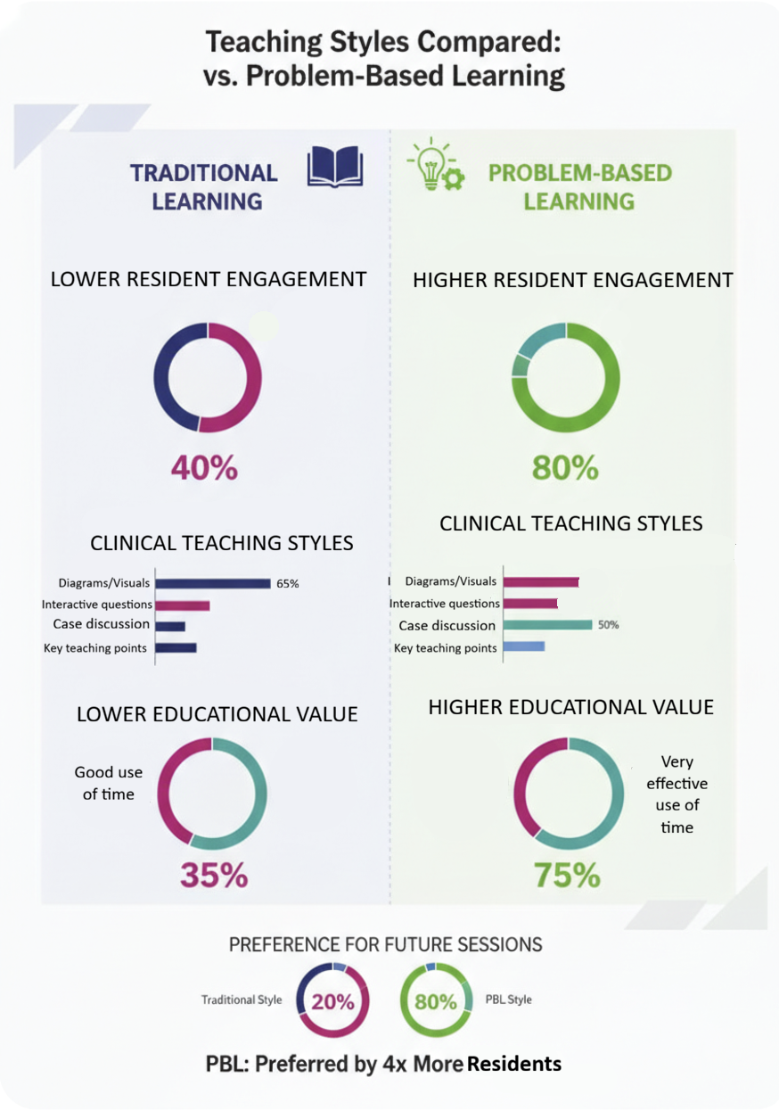
Results PDSA cycle 1
LOWER RESIDENT ENGAGEMENT
HIGHER RESIDENT ENGAGEMENT
43%
83%
PBL: Preferred by 4x More Residents
N = 52
NI X Meeting Three: October 9, 2026
Problem-Based Learning Quality Improvement Project

Slide 54
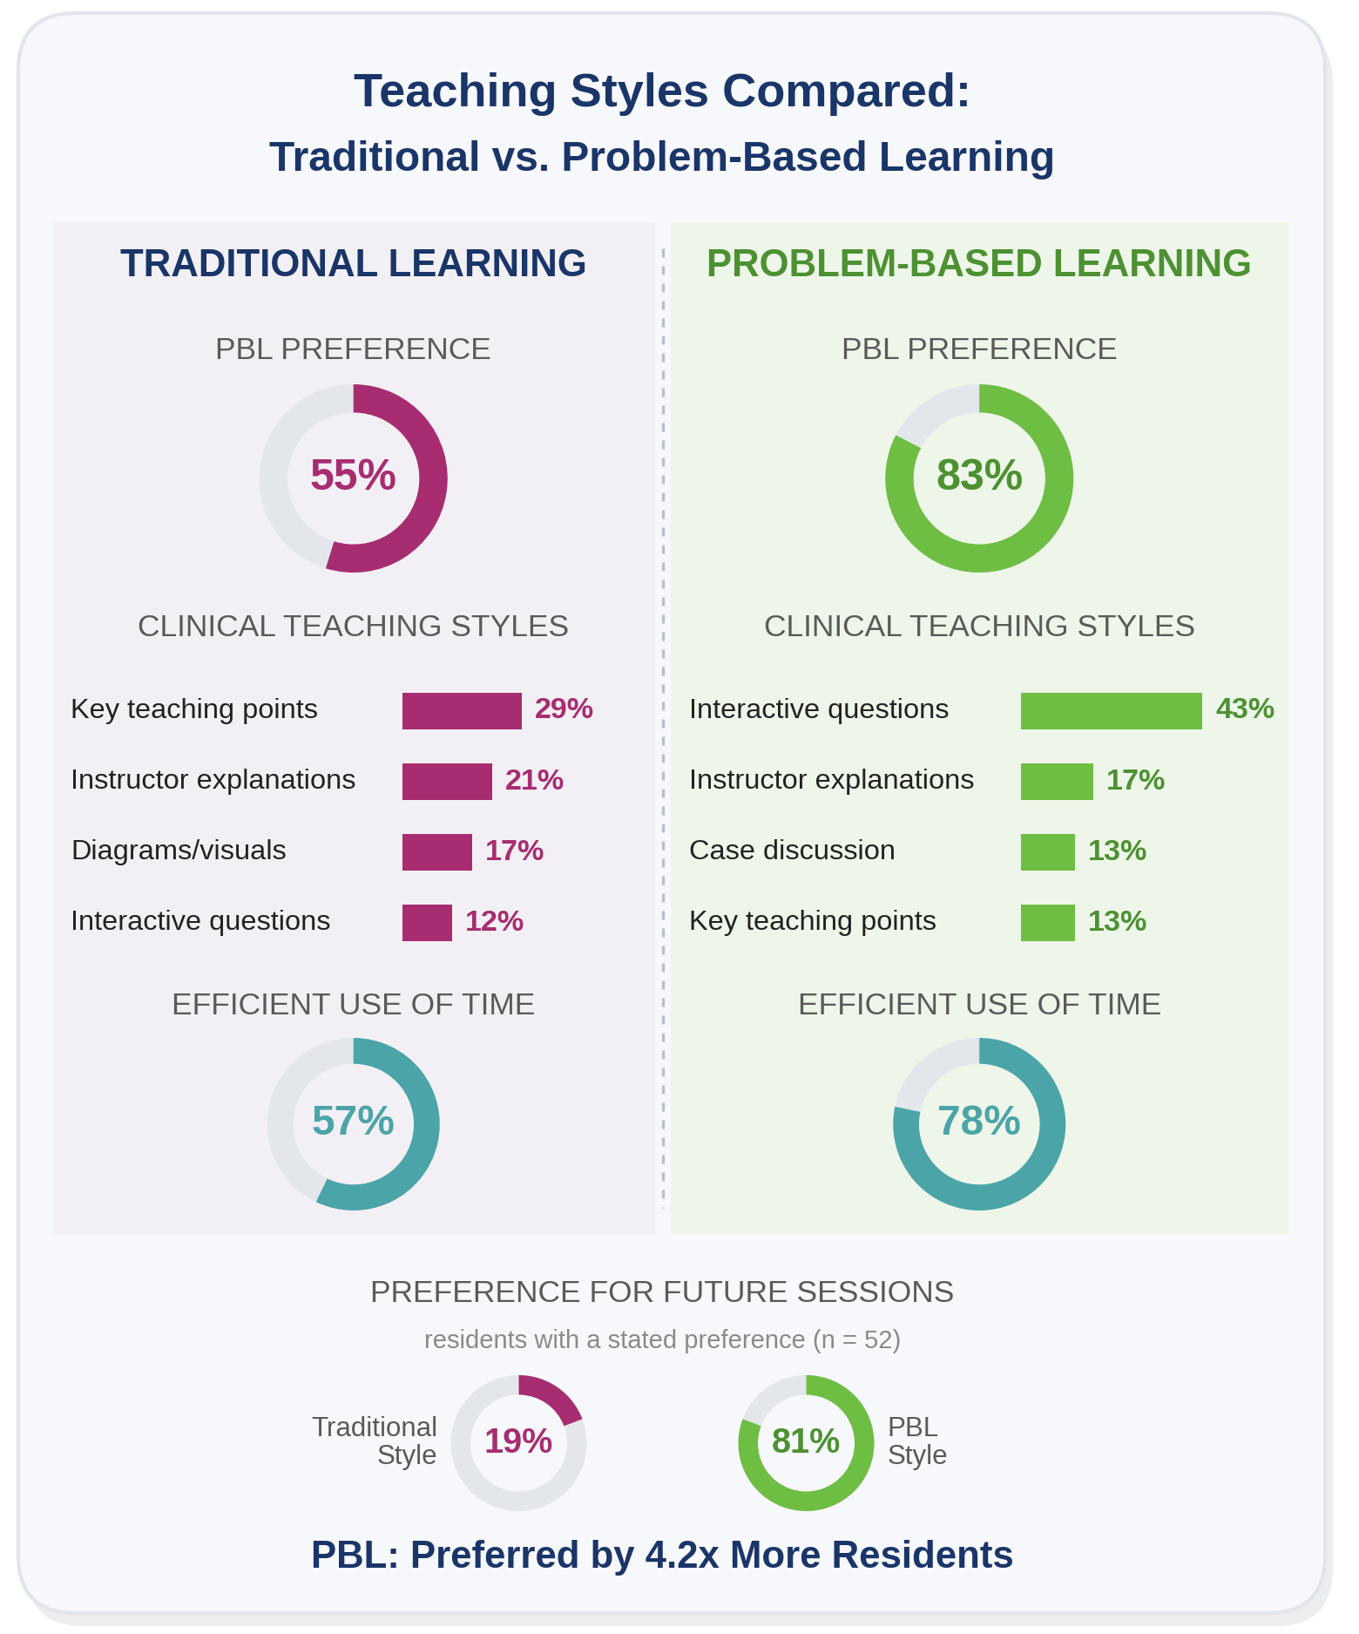
Results PDSA cycle 2
TRADITIONAL COHORT PBL PREFERENCE
PBL COHORT PBL PREFERENCE
55%
83%
PBL: Preferred by 4.2x More Residents
N = 52
NI X Meeting Three: October 9, 2026
Problem-Based Learning Quality Improvement Project

Slide 55
Discussion
Current State
Current State: PDSA Cycle 1 was initiated in August 2025 and completed in February 2026. PDSA Cycle 2 has been started in March 2026 and will conclude in March 2027.
Next Steps
Next Steps: Complete PDSA Cycle 1, collect responses for the survey till the end of PDSA Cycle 1 and analyze the results, compile results after PDSA Cycles 1 and 2 to compare the annual data.
Areas for Guidance/Input: Integrating PBL into Residency Curriculum, aligning cases with ABIM Blueprint, lessons learnt from similar PBL or active learning initiatives, guidance on curriculum integration and sustainability, as well as collaboration opportunities.
Areas for Guidance/Input
NI X Meeting Three: October 9, 2026
Problem-Based Learning Quality Improvement Project

Slide 56

Final Thoughts
Facilitator and National Advisory Council
  Victor O. Kolade, MD Core Faculty, Internal Medicine Residency, The Guthrie Clinic; Professor of Medicine & Regional Clerkship Director for Internal Medicine
  Elisa Arespacochaga, MBA, Vice President, Clinical Affairs and Workforce, American Hospital Association
  Sherry Turner, DO, MPH, Representative of the American Association of Colleges of Osteopathic Medicine

